Slide 1
Object Diagram

Slide 2
Introduction
Class represents shows the static nature of the system.
Class come to live only when objects are created from them.
Object diagram gives a pictorial representation of class diagram at any point of time.
Object are created with data. Ex.
class Invoice and properties is Invoice number so if we give invoice number then it is data.

Slide 3
Object Diagram
An object diagram shows a set of objects and their relationships at a point in time.
Object diagrams model the instances of things contained in class diagrams.
Object diagrams to model the static design view or static process view of a system.
Graphically, an object diagram is a collection of vertices and arcs.

Slide 4
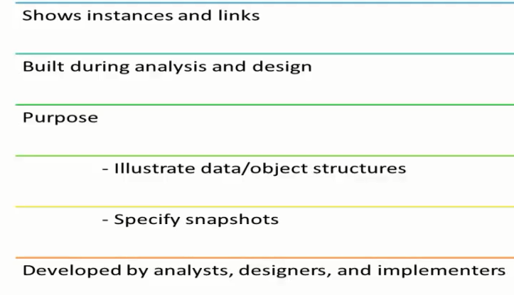
Basics

Slide 5
Contd…
Common Properties
Objects
Links
Notes and constraints

Slide 6
How to draw Object Diagram?
First, analyze the system and decide which instances are having important data and association.
Second, consider only those instances which will cover the functionality.
Third, make some optimization as the numbers of instances are unlimited.

Slide 7
Contd…
Before drawing an object diagrams the following things should be remembered and understood clearly:
Object diagrams are consist of objects.
The link in object diagram is used to connect objects.
Objects and links are the two elements used to construct an object diagram.

Slide 8
Contd…
Now after this the following things are to be decided before starting the construction of the diagram:
The object diagram should have a meaningful name to indicate its purpose.
The most important elements are to be identified.
The association among objects should be clarified.
Values of different elements need to be captured to include in the object diagram.
Add proper notes at points where more clarity is required.

Slide 9
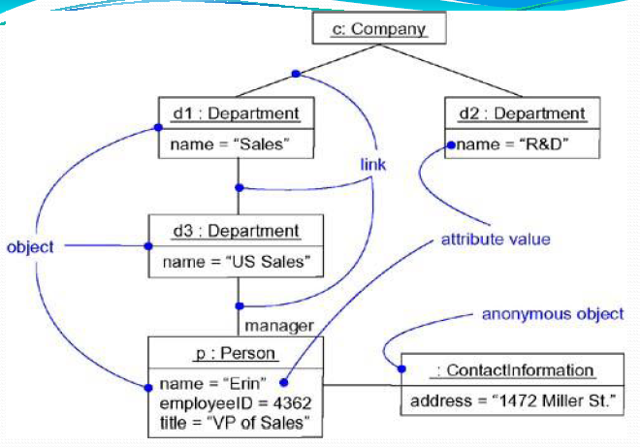

Slide 10
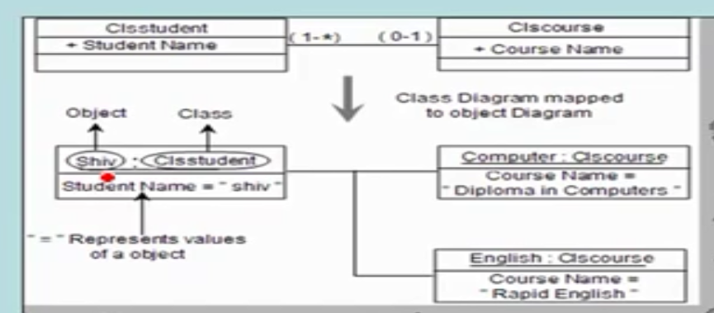

Slide 11
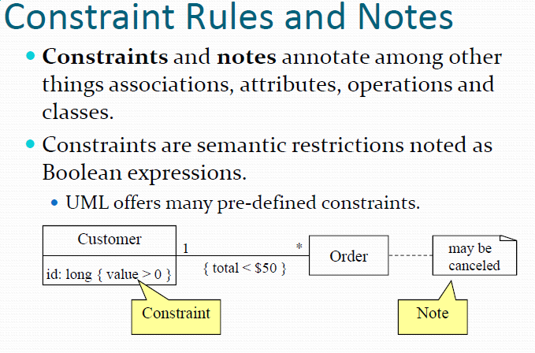

Slide 12
Order management system
Order management system which we have discussed in Class Diagram. The following diagram is an instance of the system at a particular time of purchase. It has the following objects
Customer
Order
SpecialOrder
NormalOrder

Slide 13
Now the customer object (C) is associated with three order objects (O1, O2 and O3).
These order objects are associated with special order and normal order objects (S1, S2 and N1).
The customer is having the following three orders with different numbers (12, 32 and 40) for the particular time considered.

Slide 14
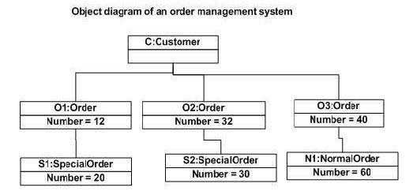

Slide 15
Conclusion
Object diagram should only be drawn to represent complicated relationship between object.
Because if you draw your class diagram with multiplicity, properties and proper relationships you will rarely need of object diagram.
But if in your project have a lot of complications or if relationship are comes on runtime then only we will use object diagram.

